Slide 1
Housing Value Resilience in TOD vs. TAD: Evidence from the City of Atlanta
Wenwen Zhang, Fangru Wang, Camille Barchers , and Yongsung Lee
School of City and Regional Planning | Georgia Institute of Technology
Presentation at the 56th ACSP Annual Conference
Nov 5th, 2016

Slide 2
Introduction
Factors influencing property values
Property level/ Neighborhood level/Accessibility
Transit-Oriented Development (TOD) has a POSITIVE effect on property values
Early studies demonstrate the importance of an INDIVIDUAL FEATURES of TOD in contributing to housing prices (Cao and Cory 1981; Song and Knaap 2004; Armstrong and Rodriguez 2006; Bowes and Ihlanfeldt 2001; Song and Knaap 2004).
Recent articles focus more on illustrating the importance of the different features’ SYNERGIZING EFFECT for making TOD effective (Bartholomew and Ewing 2011; Duncan 2010).

Slide 3
Introduction
Factors influencing property value RESILIENCE?
Highway network improvements have POSITIVE effect on housing value resilience in the aftermath of the recent real estate market crisis (Concas, 2012);
Longer term effects of social characteristics (e.g. race) have a SIGNIFICANT impact on neighborhood recovery post-recession in Metro Atlanta (E. Raymond, Wang, and Immergluck 2015).
TOD?
The recent economic recession and new open source data (e.g. Zillow) have provided a new way to study this relationship

Slide 4
Research Question
Does being located in a Transit Oriented Development (TOD) area contribute to Single Family Property Price Resilience during economic downturn, compared to being located in a Transit-Adjacent Development (TAD) area, in the City of Atlanta?
The measurement of property value resilience
Percentage of reduction in property values during the recession
Recovery of property values after the recession

Slide 5
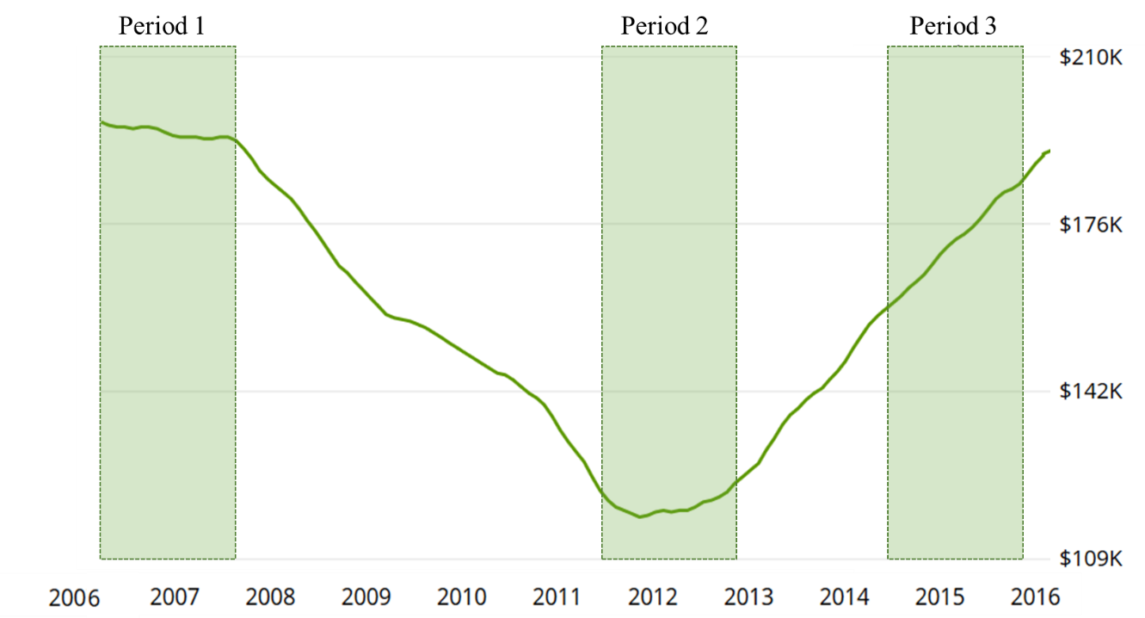
Study Time Periods
Time Period 1
[Before the Recession]
06/2006 – 11/2007
Time Period 2
[During the Recession]
06/2011 – 06/2013
Time Period 3
[After the Recession]
05/2014 – 05/2016
Atlanta Average Property Value by Year (Zillow, 2016)

Slide 6

Data Sources and Variables
Dependent Variable
Log transformed single family housing unit price (2015 $)
Independent Variables
Housing Unit Characteristics
Neighborhood Level Features
Year Built
Bedrooms #
Education Attainment
Vacancy /Ownership
Population Density
Race Poverty
Lot size
Bathrooms #
Jobs by Sector
Crime
Records
SQFT
School Districts
ACS | LEHD | Atlanta Police

Slide 7
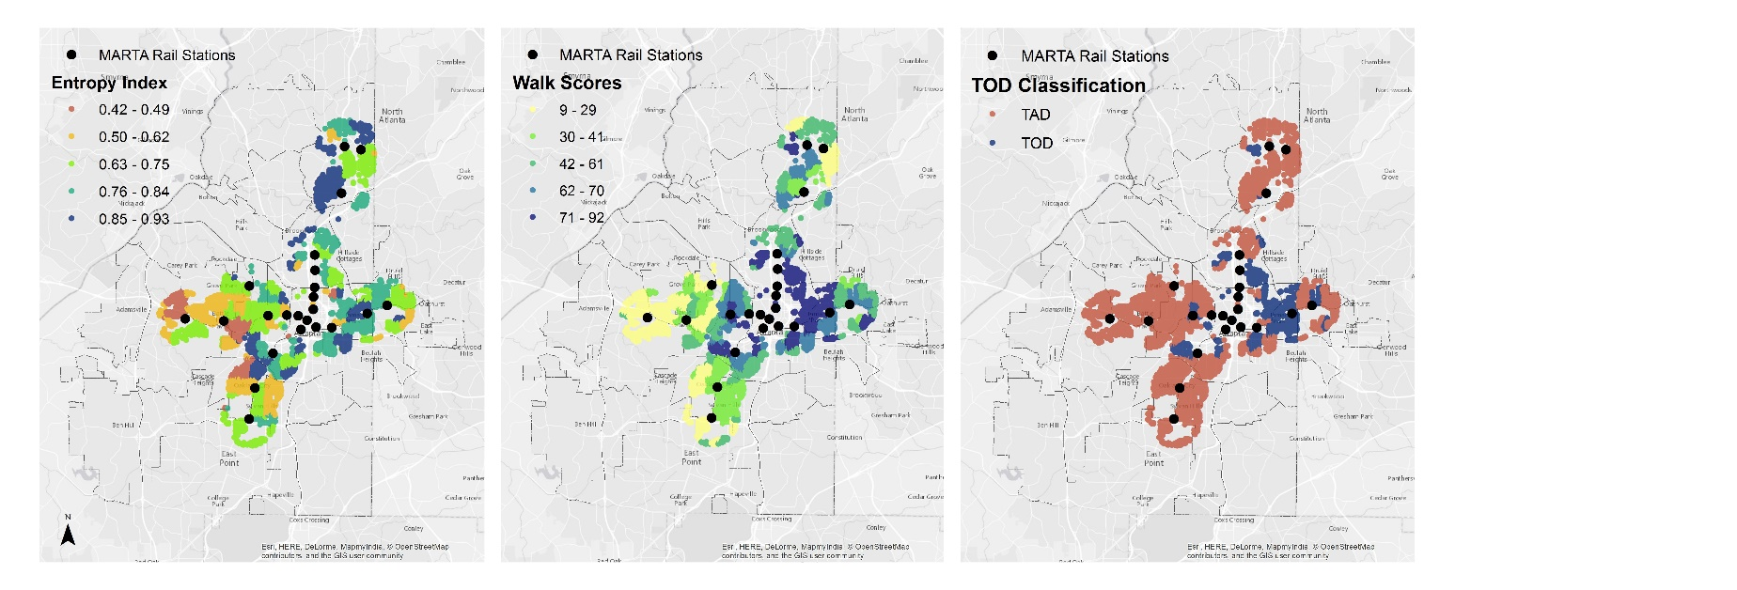
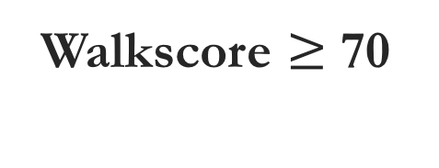

TOD vs. TAD
Entropy Index$≥$0.65
Walkscore $≥$ 70
TOD Classification
TOD is commonly defined as a medium to high density, mixed-use planned development area within walking distance around high-quality transit facilities (Cervero 2004).

Slide 8
Model Design
Before Recession
During Recession
After Recession
TWO models for TWO hypothesis separately
TOD binary variable
Time period binary variable
TOD * Time period intersect term
TAD
TOD
Values in TOD recovered faster?
Values in TOD dropped less?
Spatial Autocorrelation and Spatial Model Selection
Diagnostics for Spatial Dependence
Model 1 |  |  |  |  | Model 2
Test | MI/DF | Value | Prob. |  | Test | MI/DF | Value | Prob.
Moran's I (error) | 0.02 | 9.60 | 0.00 |  | Moran's I (error) | 0.06 | 20.93 | 0.00
Lagrange Multiplier (lag) | 1.00 | 173.34 | 0.00 |  | Lagrange Multiplier (lag) | 1.00 | 574.06 | 0.00
Robust LM (lag) | 1.00 | 88.74 | 0.00 |  | Robust LM (lag) | 1.00 | 182.11 | 0.00
Lagrange Multiplier (error) | 1.00 | 84.72 | 0.00 |  | Lagrange Multiplier (error) | 1.00 | 420.00 | 0.00
Robust LM (error) | 1.00 | 0.12 | 0.73 |  | Robust LM (error) | 1.00 | 28.05 | 0.00

Slide 9
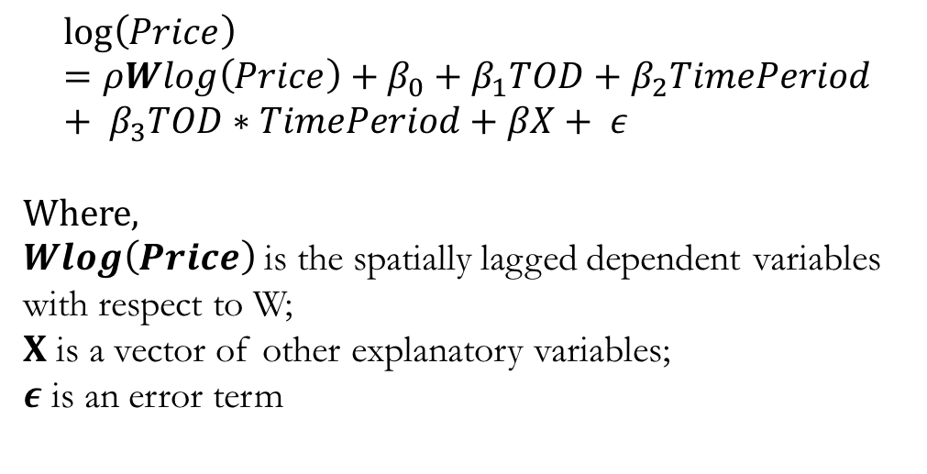
Spatial Lag Model Design
Weight Matrix [W]
Tested 1st, 2nd and 3rd Order of QUEEN Adjacency
3rd order is used in the final model
Spatial Lag Model Formula
$$\log\left(Price\right)=ρWlog\left(Price\right)+β_{0}+β_{1}TOD+β_{2}TimePeriod+ β_{3}TOD∗TimePeriod+βX+ ε$$
Where,
$Wlog\left(Price\right)$ is the spatially lagged dependent variables with respect to W;
$X$ is a vector of other explanatory variables;
$ε$ is an error term
Observation of Interest
1st Order neighbors
2nd Order neighbors
3rd Order neighbors

Slide 10
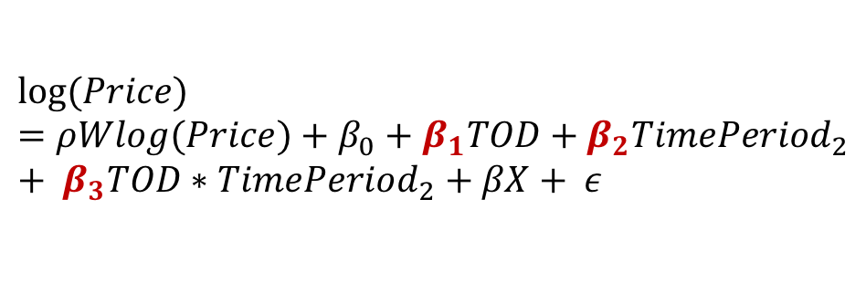
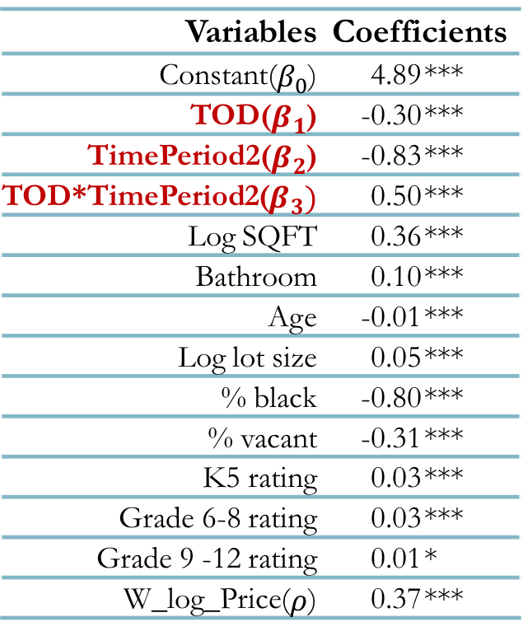
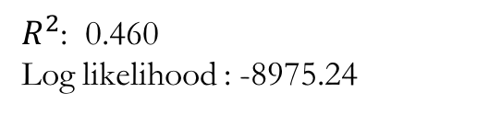
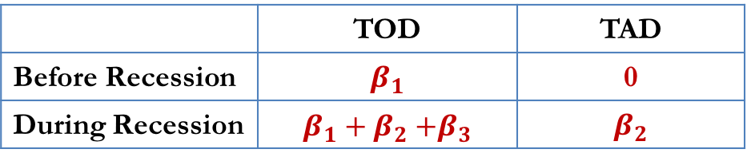
Can TOD help maintain property values?
1
Spatial Lagged Hedonic model
Variables | Coefficients
Constant($β_{0}$) | 4.89 | ***
TOD($β_{1}$) | -0.30 | ***
TimePeriod2($β_{2}$) | -0.83 | ***
TOD*TimePeriod2($β_{3})$ | 0.50 | ***
Log SQFT | 0.36 | ***
Bathroom | 0.10 | ***
Age | -0.01 | ***
Log lot size | 0.05 | ***
% black | -0.80 | ***
% vacant | -0.31 | ***
K5 rating | 0.03 | ***
Grade 6-8 rating | 0.03 | ***
Grade 9 -12 rating | 0.01 | *
W_log_Price($ρ$) | 0.37 | ***
$$log⁡(Price)=ρWlog(Price)+β_{0}+β_{1}TOD+β_{2}TimePeriod_{2}+ β_{3}TOD∗TimePeriod_{2}+βX+ ε$$
2
The effect of Recession and TOD
 | TOD | TAD
Before Recession | $$β_{1}$$ | 0
During Recession | $$β_{1}+β_{2}{+β}_{3}$$ | $$β_{2}$$
3
Model Interpretations
-26%
The effect of TOD on housing price Before Recession: exp($β_{1}$)-1
The effect of TOD on housing price During Recession: exp($β_{1}{+β}_{3}$)-1
22%
The effect of the Recession on housing price in TOD: exp($β_{2}{+β}_{3}$)-1
-28%
The effect of the Recession on housing price in TAD: exp($β_{2}$)-1
-50%
$R^{2}$: 0.460
Log likelihood : -8975.24

Slide 11

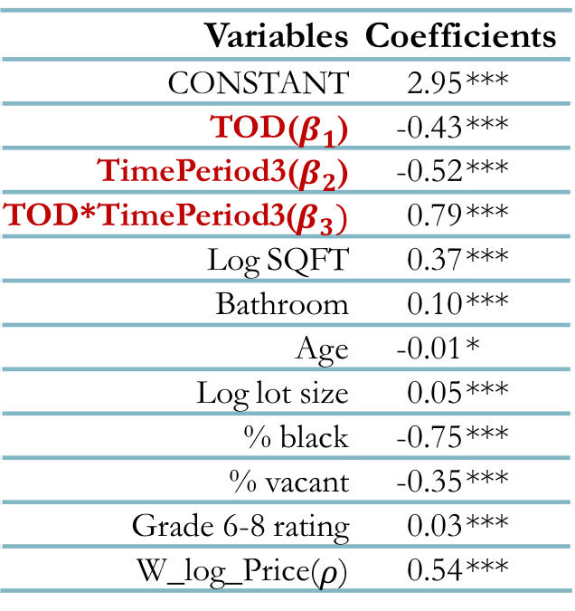
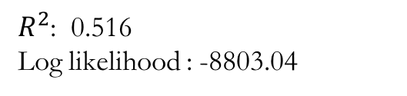

Do TOD properties recover more?
1
Spatial Lagged Hedonic model
$$log⁡(Price)=ρWlog(Price)+β_{0}+β_{1}TOD+β_{2}TimePeriod_{3}+ β_{3}TOD∗TimePeriod_{3}+βX+ ε$$
Variables | Coefficients
CONSTANT | 2.95 | ***
TOD($β_{1}$) | -0.43 | ***
TimePeriod3($β_{2}$) | -0.52 | ***
TOD*TimePeriod3($β_{3})$ | 0.79 | ***
Log SQFT | 0.37 | ***
Bathroom | 0.10 | ***
Age | -0.01 | *
Log lot size | 0.05 | ***
% black | -0.75 | ***
% vacant | -0.35 | ***
Grade 6-8 rating | 0.03 | ***
W_log_Price($ρ$) | 0.54 | ***
2
The effect of Recession and TOD
 | TOD | TAD
Before Recession | $$β_{1}$$ | 0
After Recession | $$β_{1}+β_{2}{+β}_{3}$$ | $$β_{2}$$
3
Model Interpretations
The effect of TOD on housing price After Recession: exp($β_{1}{+β}_{3}$)-1
43%
19%
The “Recover” of housing price in TOD: exp($β_{2}{+β}_{3}$)-1
The “Recover” of housing price in TAD: exp($β_{2}$)-1
-46%
$R^{2}$: 0.516
Log likelihood : -8803.04

Slide 12
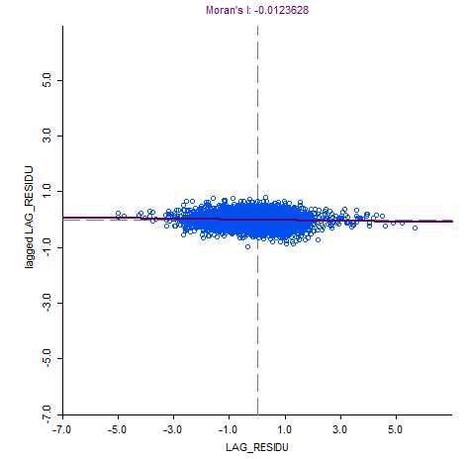
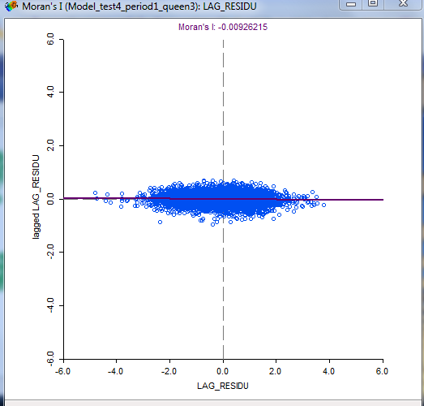
Model Diagnostics
Global Moran’s I of Residuals from Model 1
Global Moran’s I of Residuals from Model 2

Slide 13
Discussion and Conclusions
TOD can contribute to single family property value resilience
The price DROPPED LESS in TOD areas during the Recession
The price RECOVERED MORE in TOD areas after the Recession
Model Limitations
Only properties in the one-mile buffer from transit stations are included in the model (TOD without the “T”)
Only single family properties are considered in the model
Future work
Include properties outside of the buffer and develop models using panel sale records for both single family homes and condos

Slide 14
Thank you!
Wenwen Zhang |Email: wzhang300@gatech.edu
Fangru Wang |Email: fangru@gatech.edu
Camille Barchers |Email: cbarchers3@gatech.edu
Yongsung Lee |Email: yongsung.lee@gatech.edu

Slide 16
Literature Review
Factors affecting housing values
Property level factors:
Lot size, square footage, construction material, age, number of stories, number of bathrooms/bedrooms, fireplace, air-conditioning, basement, etc. (Sirmans, Macpherson, and Zietz 2005);
Neighborhood level factors:
Proximity to the central business district (CBD) or local job centers (Mathur 2008; Bartholomew and Ewing 2011; Bowes and Ihlanfeldt 2001), access to transit (Bowes and Ihlanfeldt 2001; Landis, Guhathakurta, and Zhang 1994; Knaap, Ding, and Hopkins 2001; Golub, Guhathakurta, and Sollapuram 2012), access to highway (Seo, Golub, and Kuby 2014), proximity to bike and pedestrian facilities (Welch, Gehrke, and Wang 2016; Lindsey et al. 2004; Krizek 2006), the rating of school districts (Goodman and Thibodeau 2003), proximity to natural or entertainment resources (Sander and Polasky 2009), and distance to municipal amenities (Benson et al. 1998; Shultz and King 2001), etc.
Timing factors:
Time on market, time trend that reflected the general economic projection (Sirmans, Macpherson, and Zietz 2005)
Notes:
CONVERT TO SANKEY DIAGRAM

Slide 17
Model Diagnostics
Scatter Plot of Global Moran’s I of Residuals from Model 1
Scatter Plot of Global Moran’s I of Residuals from Model 2
Diagnostics for Spatial Dependence
Model 1 |  |  |  |  | Model 2
Test | MI/DF | Value | Prob. |  | Test | MI/DF | Value | Prob.
Moran's I (error) | 0.02 | 9.60 | 0.00 |  | Moran's I (error) | 0.06 | 20.93 | 0.00
Lagrange Multiplier (lag) | 1.00 | 173.34 | 0.00 |  | Lagrange Multiplier (lag) | 1.00 | 574.06 | 0.00
Robust LM (lag) | 1.00 | 88.74 | 0.00 |  | Robust LM (lag) | 1.00 | 182.11 | 0.00
Lagrange Multiplier (error) | 1.00 | 84.72 | 0.00 |  | Lagrange Multiplier (error) | 1.00 | 420.00 | 0.00
Robust LM (error) | 1.00 | 0.12 | 0.73 |  | Robust LM (error) | 1.00 | 28.05 | 0.00

